Slide 1
Classification for Prediction module 10

Slide 2
Classification for prediction
Some classifiers are interpretable
Decision trees
Logistic regression
Some aren’t
Support vector machines
Neural network
Classification Jargon:
Class: the target attribute that we want to predict
Training set: the table (DataFrame) used to learn
Classifier: the entity that learns the differences between classes
Fit/train: the task of learning
Predict: after training, the task of predicting the class of new objects
Class
1 | 0.5 | 0.4 | 0
Training set
Fit/Train
1.3 | 2.0 | 0.3 | 0
CLASSIFIER
CLASSIFIER
1.1 | 3.0 | 1.3 | 1
0.1 | 2.5 | 0.3 | 1
Predict
Test set
1
1.4 | 2.1 | 0.9 | ?

Slide 3
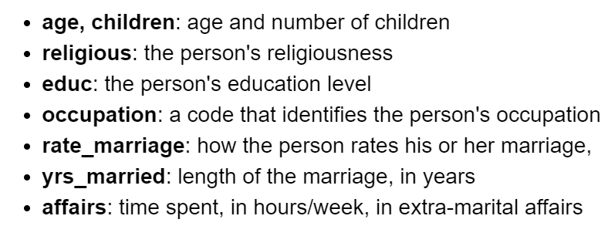
Today’s data set
Affairs.csv:
One row = one person
Columns:
Our goal is to classify cheaters

Slide 4
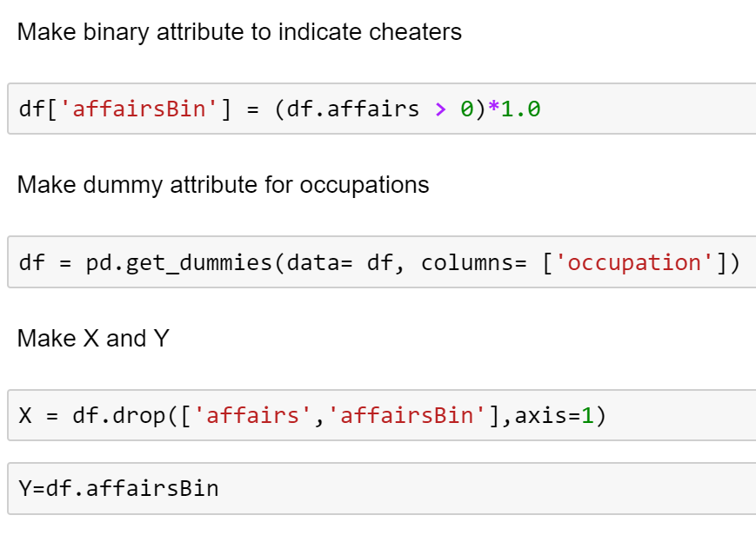
Data Preparation

Slide 5
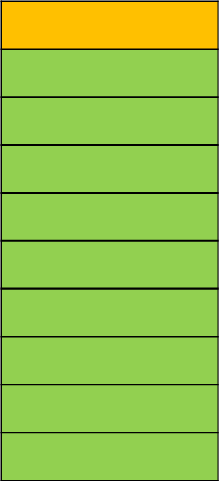
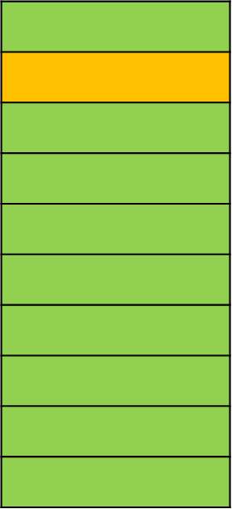
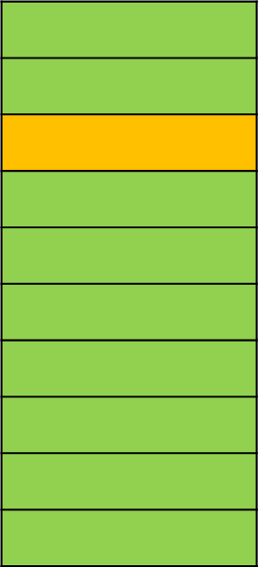
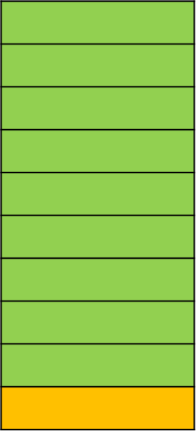
Training and Testing
Classifiers are trained on a training set
Future predictive performance is always evaluated on a different test set
We will see two methods:
Hold-out sample:
split the data into two random partitions
Train the model on one partition
Predict the class of the other partition
Cross-validation:
Partition the data set in 𝑘 parts
For 𝑘 times, use the union of 𝑘−1 partition as training set and the partition left out as test set
Training
Test
…
Iteration 1
Iteration 2
Iteration 3
Iteration 10

Slide 6
The prediction process
On a Hold-out sample

Slide 7
Step 1: split the data into training and test
Sklearn.model_selection.train_test_split
Splits the data into training set (X_train and y_train) and test set (X_test and y_test)
Test set = 30% of the data
Training set = 70% of the data

Slide 8
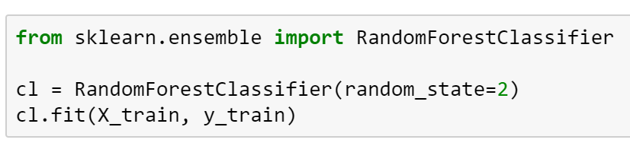
Step 2: train the classifier on the training set
Fit on the training set
Here, we use a classification technique called RandomForest.
The process is the same for any classification technique

Slide 9
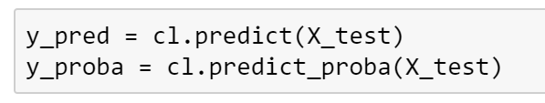
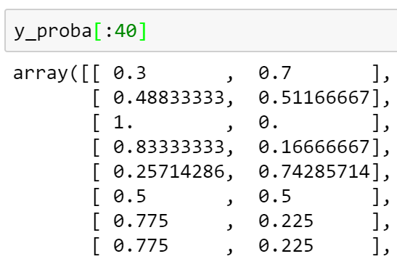
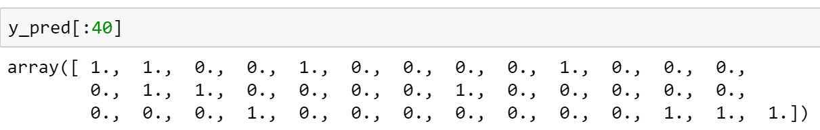
Step 3: predict on the test set
Method predict_proba:
Returns a n-by-2 matrix of probabilities of belonging to each class.
(i,0) is the probability that element i belongs to class 0
(i,1) is the probability that element i belongs to class 1
Method predict:
Returns an array of binary predictions (one for each element of the test set)

Slide 10
Evaluate the classification performance

Slide 11
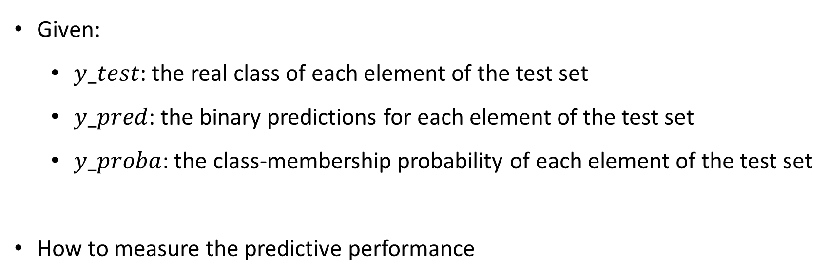
Input to Evaluate the performance
Given:
$y_test$: the real class of each element of the test set
$y_pred$: the binary predictions for each element of the test set
$y_proba$: the class-membership probability of each element of the test set
How to measure the predictive performance

Slide 12
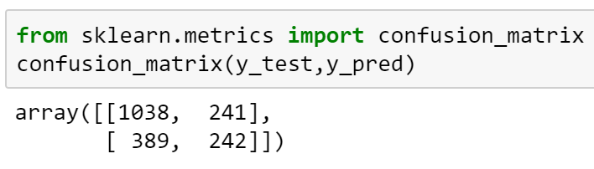
CONFUSION MATRIX
Confusion Matrix: a matrix of all outcomes on the test set:
 | Predicted non-cheaters | Predicted cheaters
Actual non-cheaters | 1033 | 362
Actual cheaters | 270 | 245
POSITIVE AND NEGATIVE:
In most binary classification problems, we are interested in detecting one class, which is usually the minority class. That class is called POSITIVE; the other one is negative. In this example, “cheaters” is the POSITIVE class.

Slide 13
True/False Positive/Negative
True Negative (TN)
False Positive (FP)
 | Predicted non-cheaters | Predicted cheaters
Actual non-cheaters | 1033 | 362
Actual cheaters | 270 | 245
True Positive (TP)
False Negative (FN)

Slide 14
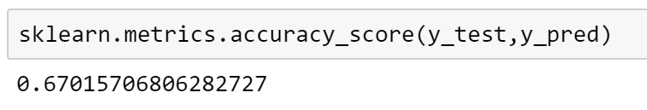
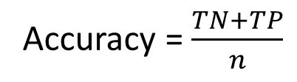
Accuracy
ACCURACY IS A BAD METRIC FOR IMBALANCED DATA
Accuracy = $\frac{TN+TP}{n}$
True Negative (TN)
 | Predicted non-cheaters | Predicted cheaters
Actual non-cheaters | 1033 | 362
Actual cheaters | 270 | 245
True Positive (TP)
In scikit-learn:

Slide 15
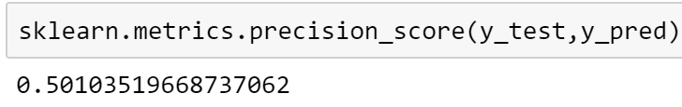
Precision
Precision = $\frac{TP}{TP+FP}$. Out of the retrieved elements, how many are actually positive?
False Positive (FP)
 | Predicted non-cheaters | Predicted cheaters
Actual non-cheaters | 1033 | 362
Actual cheaters | 270 | 245
True Positive (TP)
In scikit-learn:

Slide 16
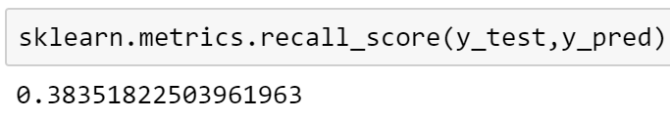
Recall
Recall = $\frac{TP}{TP+FN}$. Among the relevant elements, how many did I retrieve?
 | Predicted non-cheaters | Predicted cheaters
Actual non-cheaters | 1033 | 362
Actual cheaters | 270 | 245
False Negative (FN)
True Positive (TP)
In scikit-learn:

Slide 17
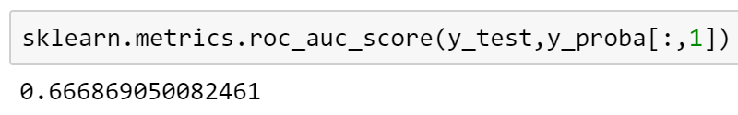
AUC score
If time at the end
AUC = Area Under the Curve (i.e., the Receiver Operating Characteristic Curve)
We won’t see the details. It measures how good a classifier is to rank the elements from the most likely to the least likely to be positive.
AUC = 0.50: random prediction
AUC = 1.00: perfect prediction
This is a commonly used metric for imbalanced data.
In scikit-learn:

Slide 19
Cross-validation

Slide 20
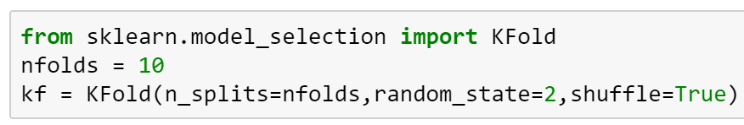
Step 1: create the fold-maker

Slide 21
Step 2: Execute the cross-validation
The whole data set
The classifier
The fold maker
The result is an array of scores (in this case, AUC scores)
The metric to collect:
‘accuracy’
‘precision’
‘recall’
‘f1’
‘roc_auc’

Slide 22
Select the best classifier

Slide 23
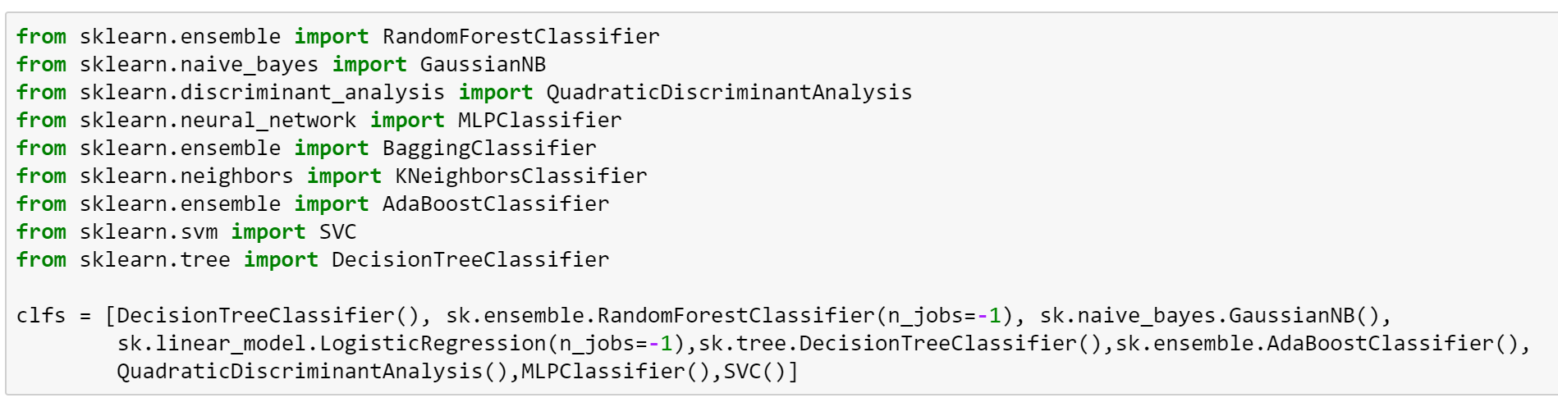
Here are some classifiers

Slide 24
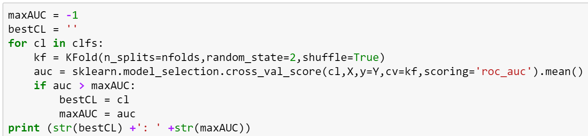
Find the best one
For each classifier:
Run a cross validation and record the average AUC
Store the information on the classifier that obtains the largest AUC

Slide 25
More Practice on Classification
Consider the data set cleaned_survey.csv
Exploratory: What is the difference between MSIS and MBA students?
Predictive: Can you accurately predict the program of a new unseen student whose program is unknown?

